Slide 1


Road Lane Detection
MAHATMA EDUCATION SOCIETY’S
PILLAI HOC COLLEGE OF ENGINEERING
AND TECHNOLOGY
GROUP MEMBERS:-
Shubham Gajarushi (11)
Dnyaneshwari Hande (22)
Gaurav Parab (43)
Under the guidance of:-
Mrs. Poonam Pathak

Slide 2
INDEX
1. Introduction
2. Objectives
3. Problem Statement
4. Proposed System
5. Flowchart of Proposed System
6. Requirements
7. Methodology
8.Outputs
9. Future Scope
10. Advantage
11.Conclusion
12. References

Slide 3
Introduction
If we talk about most futuristic technology of this decade after 5g is self driving cars. and within the self drive car road line detection comes out as important technique.
Each used algorithm is described in details, implemented and its performance is evaluated using actual road images and videos captured by the front mounted camera of the car.
Increasing safety , reducing road accidents and enhancing comfort and driving experience are the major motivations behind this project.

Slide 4
Objectives
The proposed lane detection system can be applied on both painted as well as curved and straight road in different weather conditions. It does not require any extra information such as lane width, time to lane crossing and offset between the center of the lanes. In addition, camera calibration and coordinate transformation are also not required.
The system has demonstrated a robust performance for detecting the road lanes under different conditions.

Slide 5
Problem Statement
There are so many other objects in the scene apart from the lane markings.
There are vehicles on the road, road-side barriers, street-lights, etc. And in a video, a scene changes at every frame. This mirrors real-life driving situations pretty well.
One thing we can do right away is to narrow down the area of interest. Instead of working with the entire frame, we can work with only a part of the frame.
In the image below, apart from the lane markings, everything else has been hidden in the frame.

Slide 6
Proposed System
The system proposed is a one which uses algorithms such as canny edge detection and detect various edges present in the input image frame.
After recognition of these edges, the system concludes them to be marked lane on the road and shows edges by highlighting them to the user.
This system can be implemented to help autonomous driving systems to understand lane markings better and improve the overall safety and lane discipline of these autonomous vehicles.
Initially the user needs to input a video sequence to the system after a video sequence is detected then the system applies the canny edge detection algorithm.
Hough transform is used to identify the left and right lane boundaries

Slide 7
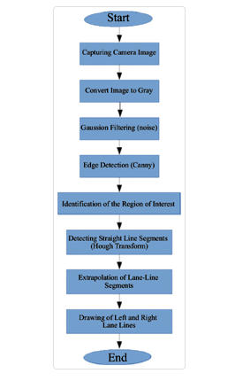
Flowchart of Proposed System

Slide 8
Technology Used
Software
Hardware
Visual Studio Code
OS – Windows 11
Ram – 8GB

Slide 9
Technology Used
Languages
Libraries
Python
Open CV2
Numpy
Time
Imutile

Slide 10
Methodology
Pre-process image using grayscale and gaussian blur
Apply canny edge detection to the image
Apply masking region to the image
Apply Hough transform to the image
Extrapolate the lines found in the Hough transform to construct the left and right lane lines
Add the extrapolated lines to the input image

Slide 11
HOUGH TRANSFORM
The Hough transform is a feature extraction technique used in image analysis, computer vision, and digital image processing.
The classical Hough transform was concerned with the identification of lines in the image, but later the Hough transform has been extended to identifying positions of arbitrary shapes, most commonly circles or ellipses.
The Hough transform as it is universally used today was invented by Richard Duda and Peter Hart in 1972, who called it a "generalized Hough transform“.

Slide 12
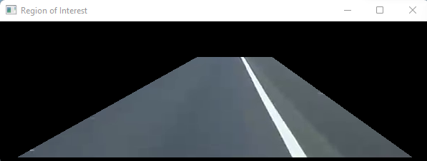
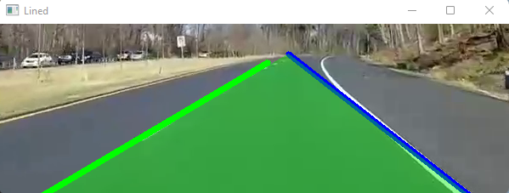
Output

Slide 13

Future Scope
The main advantage of this approach is that it requires no trained model to predict the lanes on the road.
Rather it actively takes in the video frames as input and actively detects the edges in the frame which are then given back as lanes to the user.
This is an advantage as no time is spent developing a dataset, training, and testing it.
This system provides the user to quickly implement lane detection in their implementation of autonomous driving systems.
Moreover, this system can be utilized by highway cameras to find and penalize vehicles which are not following lane discipline thereby endangering the others traveling on the same road.

Slide 14
Advantage
The main advantages are:
1. Our roads will be safer
2. We’ll be more productive
3. We can save money
4. We’ll move more efficiently
5. The environment will thank us

Slide 15
Conclusion
In this system , lane detection method was proposed.
Image segmentation and remove the shadow of the road were processed.
Canny operator was used to detect edges that represent road lanes or road boundaries.

Slide 16
References
https://www.researchgate.net/publication/336255086_Road_Lane-Lines_Detection_in_Real-Time_for_Advanced_Driving_Assistance_Systems
https://view.genial.ly/61261c90cf50571001c20793/presentation-road-lane-line-detection

Slide 17
Thank You

